Slide 1
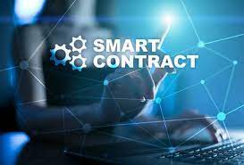
Smart Contract
Smart Contract process
Types of Smart contract
Benefits of Smart Contract
Applications: Crowdfunding and Voting Process

Slide 2
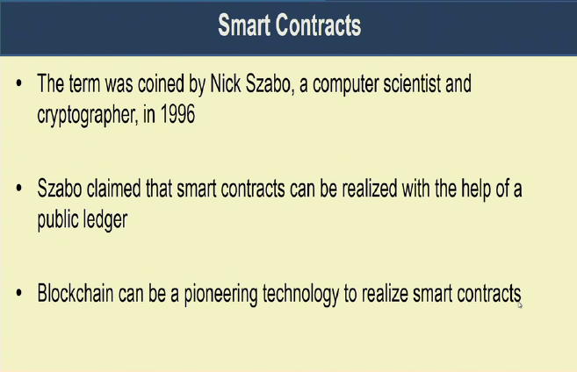

Slide 3
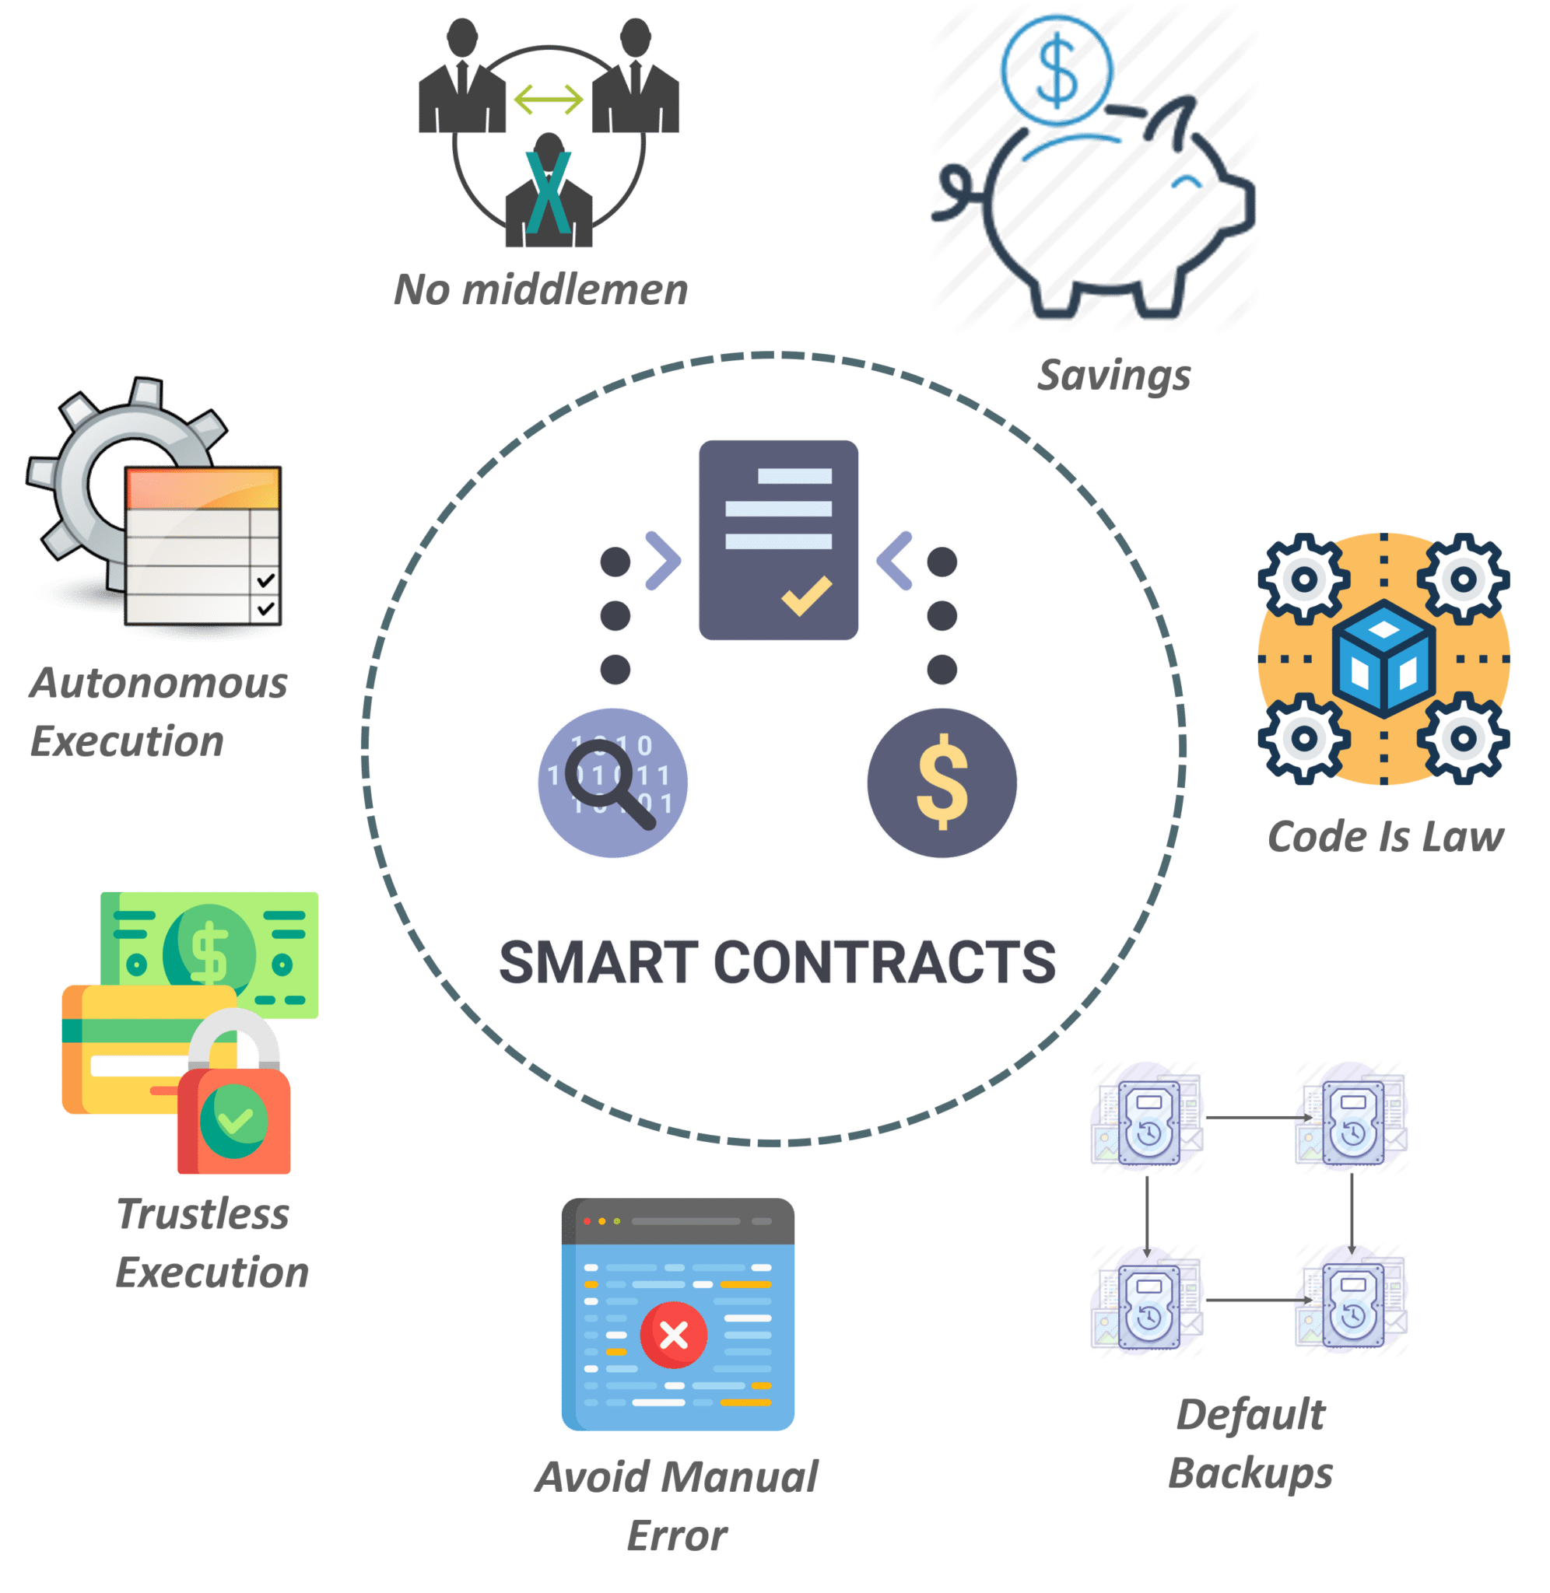
Smart Contract: Definition, Key features
A smart contract an simply be defined as a computer code that runs on top of the blockchain. It contains a set of rules that determine how the involved parties can interact with each other. So, whenever these predefined rules are met, automatically the agreement is enforced. It’s the purest form of decentralized automation.
The smart contract code is responsible for facilitating, verifying, and enforcing the negotiation or performance of a transaction or an agreement.

Slide 4
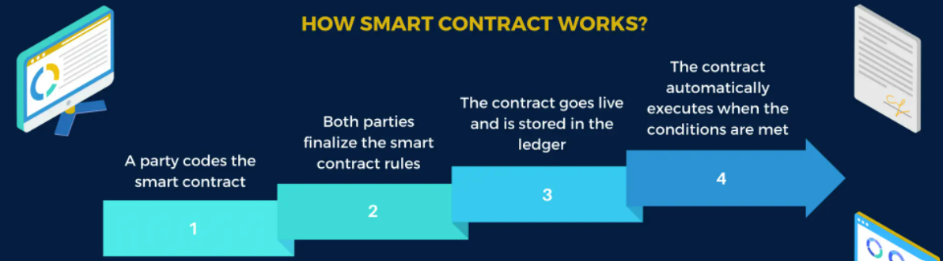
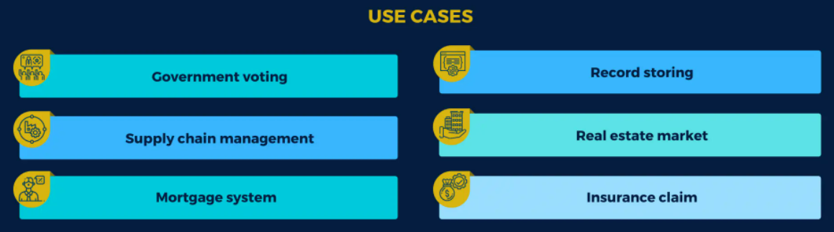
Smart Contract Process

Slide 5
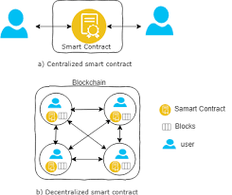
Centralized Vs Decentralized Smart Contract

Slide 6
Types of Smart Contract
Deterministic Smart Contract & Non-Deterministic Smart Contracts
Deterministic smartcontracts are smartcontract codes that do not depend on outside information other than information on the Blockchain in which they live into be triggered and work effectively. In other words, the Blockchain network facilitating the smartcontract has sufficient information to make decisions.
E.g.,
peer-to-peer lottery: the fundsare held on the Blockchain network and random numbers are also generated by the smartcontract code. At the end of the lottery, the fundsare transferred the winners account via his or her address on the Blockchain network

Slide 7
Types of Smart Contract
In Non-Deterministic smartcontracts the network facilitating the smartcontract code does not have sufficient information to make decisions. Thus an outside party is needed,usually called an‘Oracle’ in the computer science domain.
Decisions about value flow based on human behavior, events(price drop or hike) or predictions.However,research has shown that using external state does not always introduce the need for trusting an additional party.
For example, in a driving license renewal scenario, the government is a trusted party anyway, thus, we use government as a validation oracle that injects external state into the blockchain.

Slide 8
Benefits Of Smart Contracts
Accuracy, Speed, and Efficiency
The contract is immediately executed when a condition is met.
Because smart contracts are digital and automated, there is no paperwork to deal with, and
No time was spent correcting errors that can occur when filling out documentation by hand.
Trust and Transparency
There's no need to worry about information being tampered with for personal gain because there's no third party engaged and
Encrypted transaction logs are exchanged among participants
Security
Because blockchain transaction records are encrypted, they are extremely difficult to hack.
Furthermore, because each entry on a distributed ledger is linked to the entries before and after it, hackers would have to change the entire chain to change a single record.
Savings Time
Smart contracts eliminate the need for intermediaries to conduct transactions, as well as the time delays and fees that come with them.

Slide 9
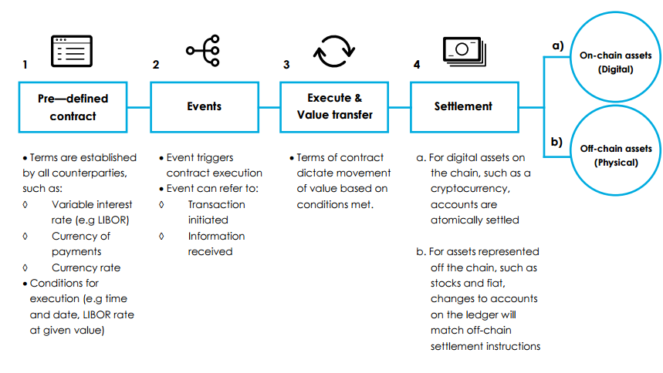
Smart Contract Process

Slide 10
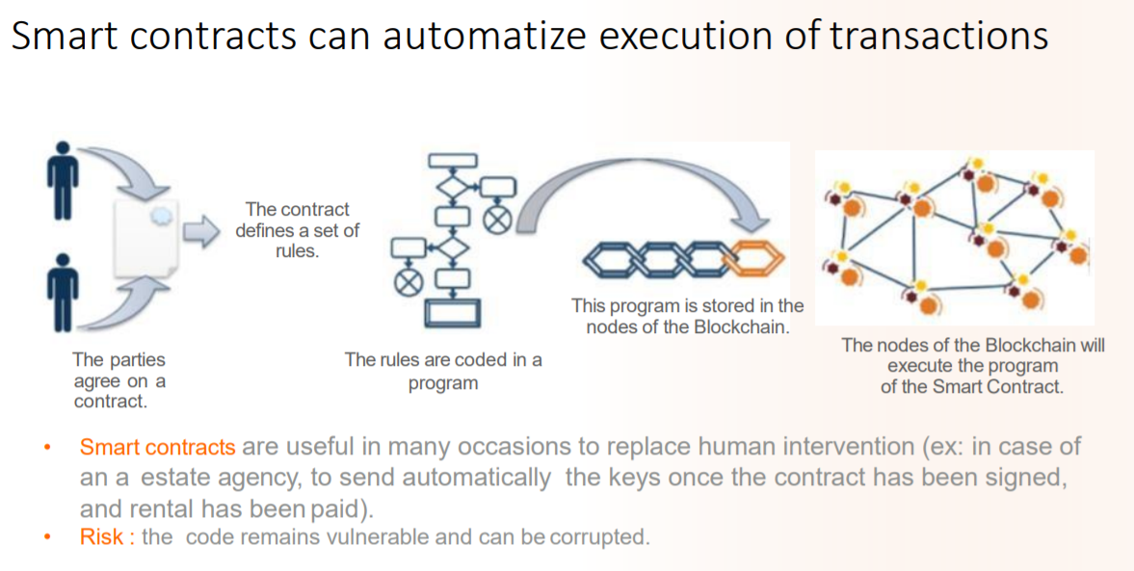

Slide 11
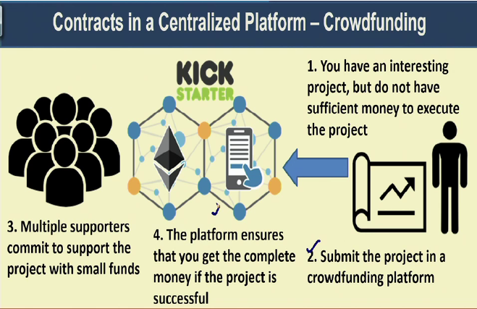
Application of Smart Contract

Slide 12
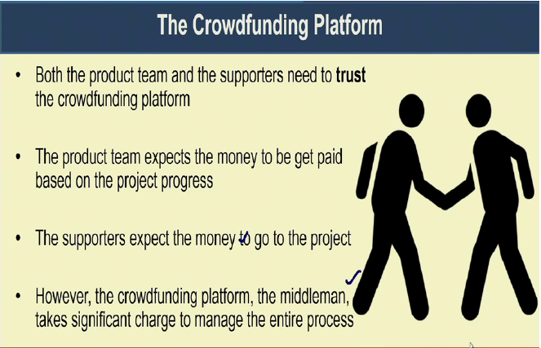

Slide 13
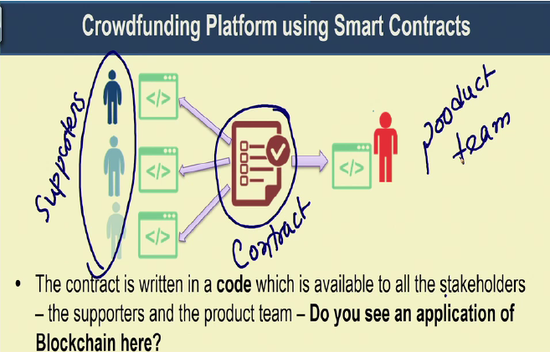

Slide 14
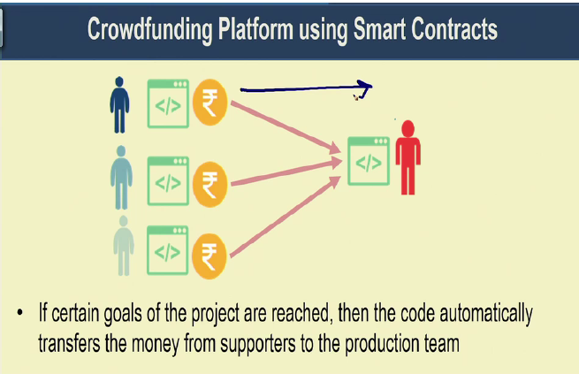

Slide 15
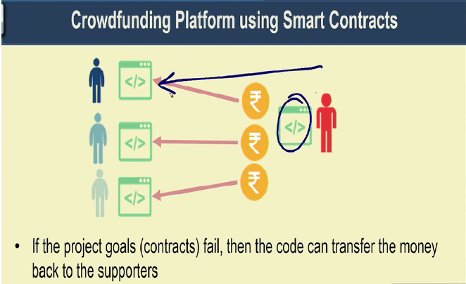

Slide 16
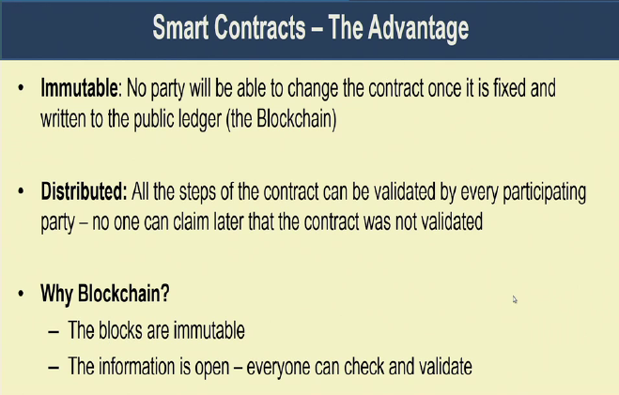

Slide 17
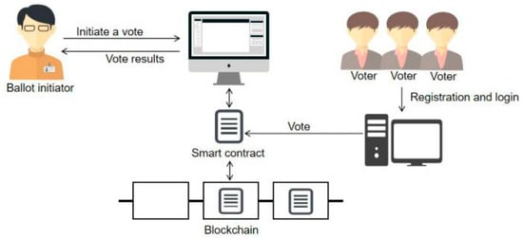
Voting and Blockchain Implementation of Smart Contracts
A centralized voting system faces difficulties when it comes to tracking votes – identity fraud, miscounts, or bias by voting officials.
Using a smart contract, certain predefined terms and conditions are pre-set in the contract. No voter can vote from a digital identity other than his or her own. The counting is foolproof. Every vote is registered on a blockchain network, and the counting is tallied automatically with no interference from a third party or dependency on a manual process. Each ID is attributed to just one vote.
Validation is accomplished by the users on the blockchain network itself. Thus, the voting process can be in a public blockchain, or it could be in a decentralized autonomous organization-based blockchain setup. As a result, every vote is recorded on the ledger, and the information cannot be modified. That ledger is publicly available for audit and verification.
Smart contracts allow you to create voting systems in which you can add and remove members, change voting rules, change debating periods, or alter the majority rule. For instance, you can create a vote for a decision within a decentralized autonomous organization. Rather than a central authority making a decision, a voting mechanism within the organization can determine whether the proposal is accepted or rejected.

Slide 18
Thank You

